Slide 1

Asura: A 3D Storyline using Unity Engine
Group No. 07
Aaryan Parab 18104060
Nikhil Rathod 18104001
Tanaya Patil 18104022
Project Guide Prof. Neha Deshmukh

Slide 2
Contents
Introduction
Objectives
Problem Definition
Technological Stack
Review Suggestions (Given in Last meeting)
Proposed System Architecture/Working
Prototype Design Demonstration
Implementation Status
Status of Paper Draft & Targeted Conference

Slide 3
1. Introduction
Problem Identified:
Indian culture has played an important role in molding our lives. Now-a- days our new generation is steering a course towards Modernization and western culture and we can see lack of interest in Indian Culture and Mythology in our younger generation.
Solution Proposed:
To overcome this problem we will develop 3D video game that will introduce youngsters to Indian Mythological Concepts in a interactive as well as fascinating way.

Slide 4
2. Objectives
To build a video game involving the Indian Culture.
To involved youngsters in Indian Culture in an entertaining way.
To build 3 dimensional visual world with high graphics.
To create an exciting game scenes and animations using Unity3D and After Effects.
To achieve perfect efficiency in creating 3D modelling using blender
To create ,edit and restoring audio using Auditions.

Slide 5
3. Problem Definition
The young Indian more obsessed with the latest trends of globalization.
To overcome this problem we have implemented a solution in which 3D game will be made to increase youngsters involvement in Indian culture and Mythology in an interactive as well as in fascinating way.

Slide 6
4. Technological Stack
Unity 3D: To Build game scenes
Blender/Maya: To create 3D Models.
Photoshop/Illustrator: To edit the models used in games.
Audition Tool: To create or edit the audio.
After Effects Tool: To give an animation.

Slide 7
5. Reviews and Suggestions
1. To work on the title of the project.

Slide 8
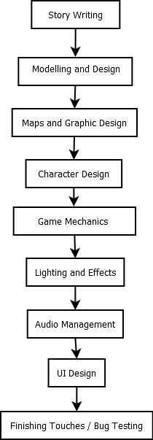
6. Proposed System Architecture/ Working

Slide 9
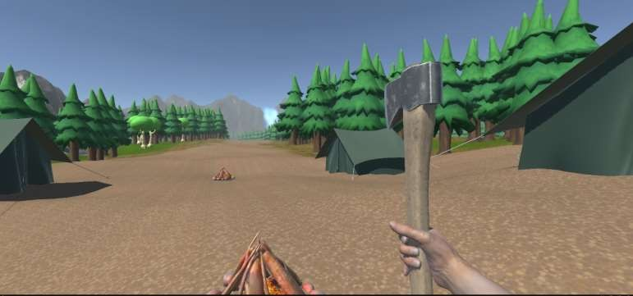
7. Prototype Design Demonstration
Fig 7.1 Level 1

Slide 10
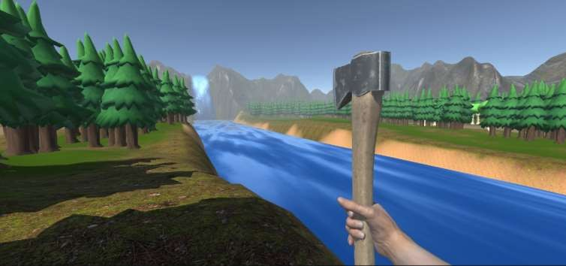
Fig 7.2 Level 1

Slide 11
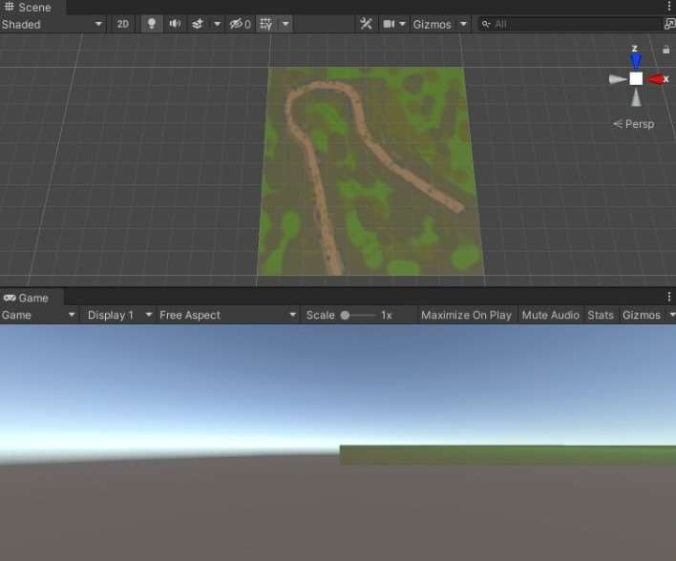
Fig 7.3 Level 3

Slide 12
8. Implementation Status
Done with the two levels.
Done with the player’s and enemy’s movements.
Done with the Inventory GUI System.
Done with the health bar system.

Slide 13
9. Status of Paper Draft
Research Paper is ready to publish.
The paper submission has done for IEEE conference.
Project Synopsis in LaTeX format has been completed and approved by the
guide.

Slide 14
Thank You...!!

